Slide 1





|| Jai Sri Gurudev||
Sri Adichunchanagiri Shikshana Trust®
SJB INSTITUTE OF TECHNOLOGY
(Affiliated to Visvesvaraya Technological University, Belagavi & Approved by AICTE, New Delhi.)
Accredited with NAAC ‘A’ grade
No. 67, BGS Health & Education City, Dr. Vishnuvardhan Road Kengeri, Bengaluru – 560 060
Department of Computer Science Engineering
INTERNSHIP PRESENTATION
ON
ORACLE APEX
CARRIED OUT AT
Cognizant Technology Solutions
Under The guidance of Mrs. Shubha T V
Presented by
A S Harini 1JB21CS004

Slide 2
OVERVIEW OF INTERNSHIP WORK
Duration: March 2025 to June 2025
Company: Cognizant Technology Solutions, Chennai
The internship is divided into three phases:
Delta Phase: Focuses on PL/SQL, HTML, CSS, XML, REST web services, UNIX, and Python.
Interim Phase: Emphasizes OCI, OIC, and OCIDI.
Final Phase: Concentrates primarily on APEX, which is the main area of work.
I am currently in the final phase of the internship.

Slide 3

COGNIZANT
Cognizant Technology Solutions is an American multinational company specializing in IT consulting and outsourcing. Its headquarters are located in New Jersey, USA, though it was originally founded in Chennai, India.
The company's primary services include cloud computing, AI and analytics, enterprise application services, consulting, and IT infrastructure. With a global workforce of approximately 336,800 employees, about 75% of its staff are based in India.

Slide 4
ENTERPRISE PLATFORM SERVICES (EPS)
It focuses on helping clients transform their core business operations using powerful enterprise platforms.
Service Lines of EPS: HCM, ERP, Digital Process Orchestration, Digital Supply Chain Transformation, Platform Integration.
Subdomains of EPS: SAP services, Oracle APEX, Salesforce Services, Workday Services.
Focus: Build low-code web applications, role-based access, dynamic forms, interactive reports.

Slide 5
TASKS PERFORMED
Delta phase:
This phase primarily covered the fundamentals of PL/SQL, HTML, CSS, JavaScript, XML, REST web services, UNIX, and Python. These topics served as prerequisites for our training. We learned how to write basic PL/SQL queries using triggers, procedures, functions, and cursors. Additionally, we explored XML formats, simple Python codes, and UNIX commands. We also gained knowledge on working with REST APIs.

Slide 6
Interim Phase
It comprised mainly of OIC, OCI, and OCIDI.
OIC: Oracle Integration Cloud is a Platform-as-a-Service (PaaS) solution designed to facilitate data exchange and communication between cloud and on-premise systems.
OCI: Oracle Cloud Infrastructure is an Infrastructure-as-a-Service (IaaS) offering that enables the building, deployment, and management of applications in the cloud.
OCIDI: Oracle Cloud Infrastructure-Data Integration is a cloud-based service focused on ETL/ELT processes, primarily used for extracting, transforming, and loading data.

Slide 7

OIC
We primarily focused on designing integrations, connections, adapters, agents, events, libraries, packages, and lookups. Additionally, we explored various actions in OIC, such as assign, map, wait, logger, notifications, and callback services.
Our training also covered inbound and outbound connections to OIC, with a strong emphasis on bulk loading. Furthermore, we learned about key SaaS services available in the cloud, including ERP, SCM, and HCM.

Slide 8
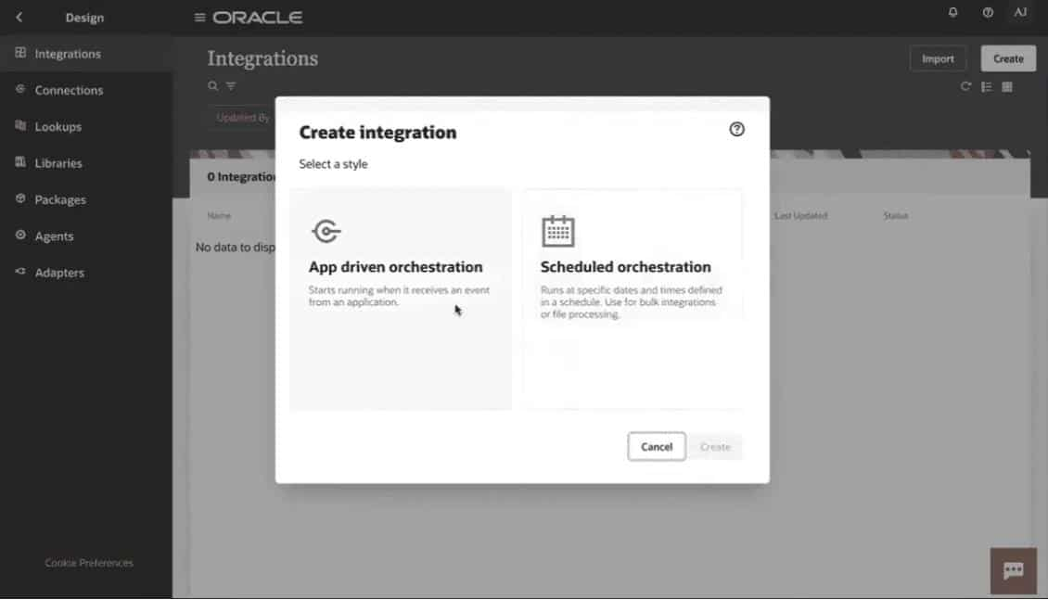
OIC Console

Slide 9
OCI
This phase primarily covered cloud computing services and deployment models. In OCI, the process begins by logging into the console and creating a tenancy, followed by the creation of a compartment. Next, a Virtual Cloud Network (VCN) is established for internet connectivity.
A compute instance is then launched and accessed using SSH keys. Subsequently, object storage is set up for storing objects, and an IAM policy is created to grant access to user groups.

Slide 10
OCIDI
OCIDI Features: The key features of OCIDI include no-code data flow, immersive data experience, automated schema drift protection, hybrid data execution, optimization for Oracle, and a pay-as-you-go model.
Use Cases: OCIDI is primarily used for data integration in big data environments, data lakes, rapid data ingestion, and ingestion from multiple sources.
Components: OCIDI mainly comprises tasks, pipelines, and dataflows.
Task Types: Various types of tasks can be created based on requirements, such as data loader tasks, integration tasks, pipeline tasks, REST tasks, SQL tasks, and OCI dataflow tasks.

Slide 11
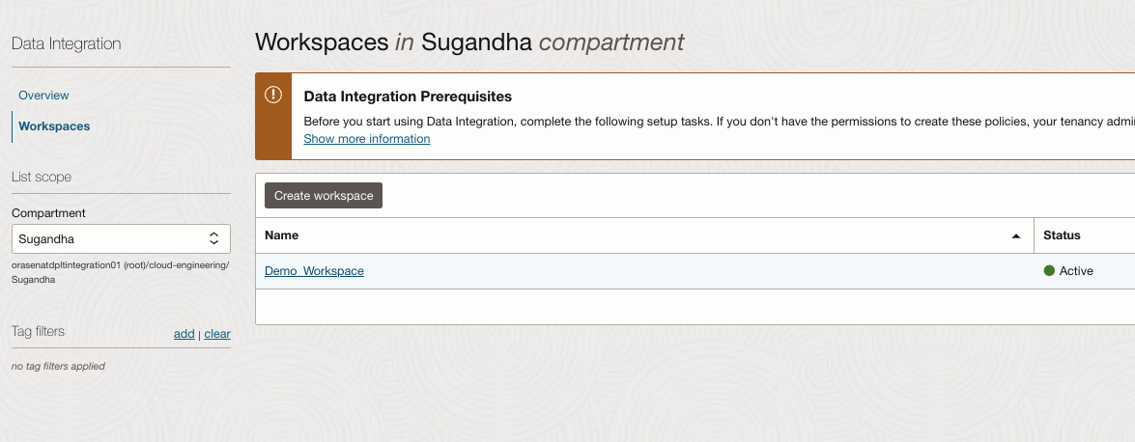
OCIDI

Slide 12
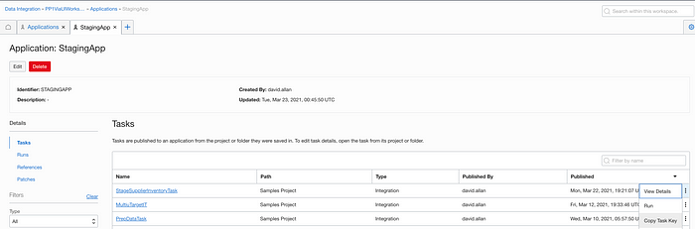
OCIDI

Slide 13
APEX (FINAL PHASE)
We are currently in the final phase of our internship, focusing on APEX. APEX, or Application Express, is a low-code development platform provided by Oracle that enables the creation of secure and scalable web applications.
It is seamlessly integrated with the Oracle Database and is entirely web-based. We have developed several applications using APEX during this phase.

Slide 14
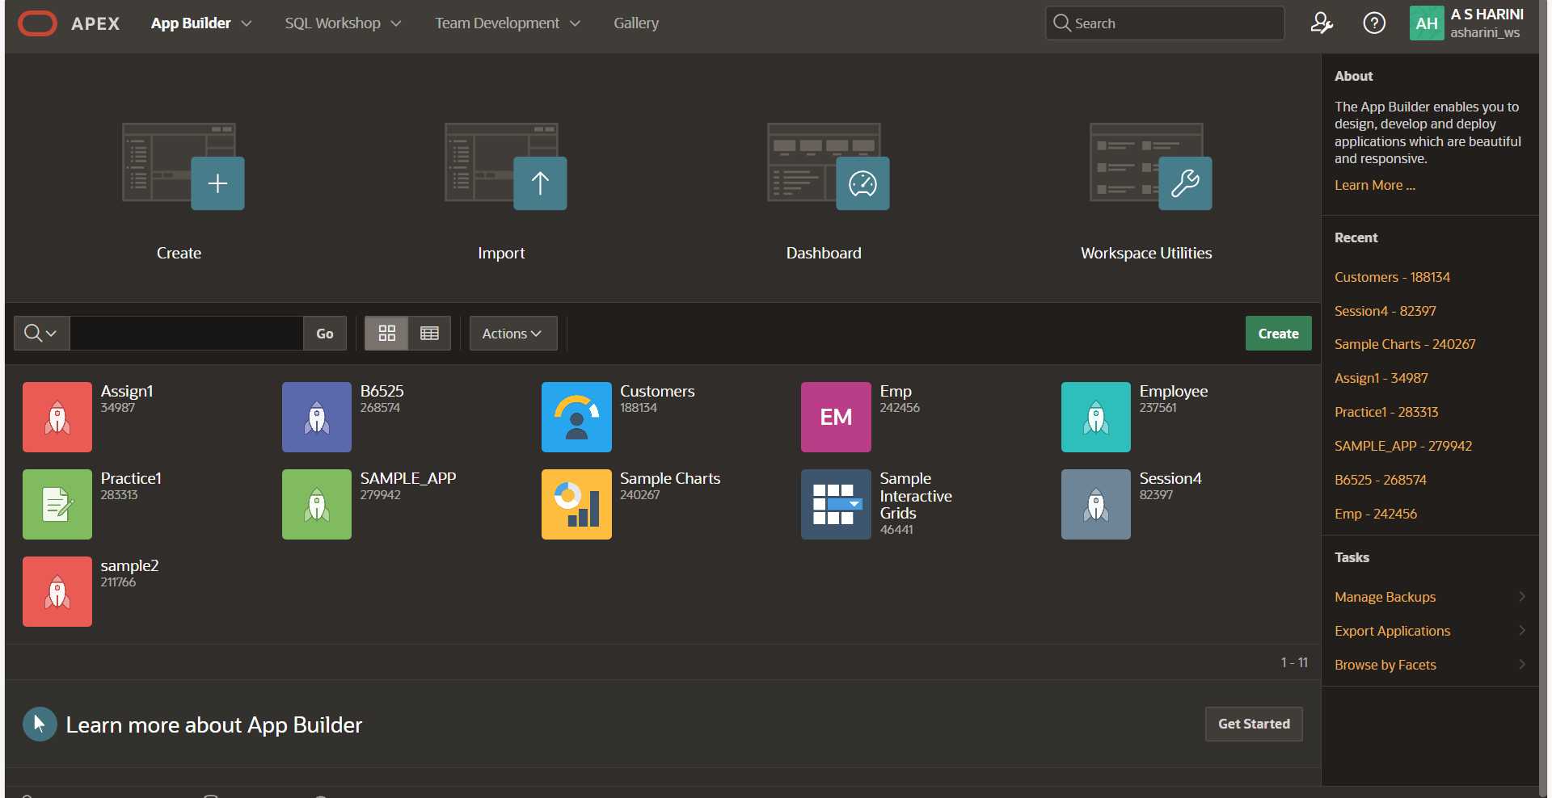
APEX HOME PAGE

Slide 15
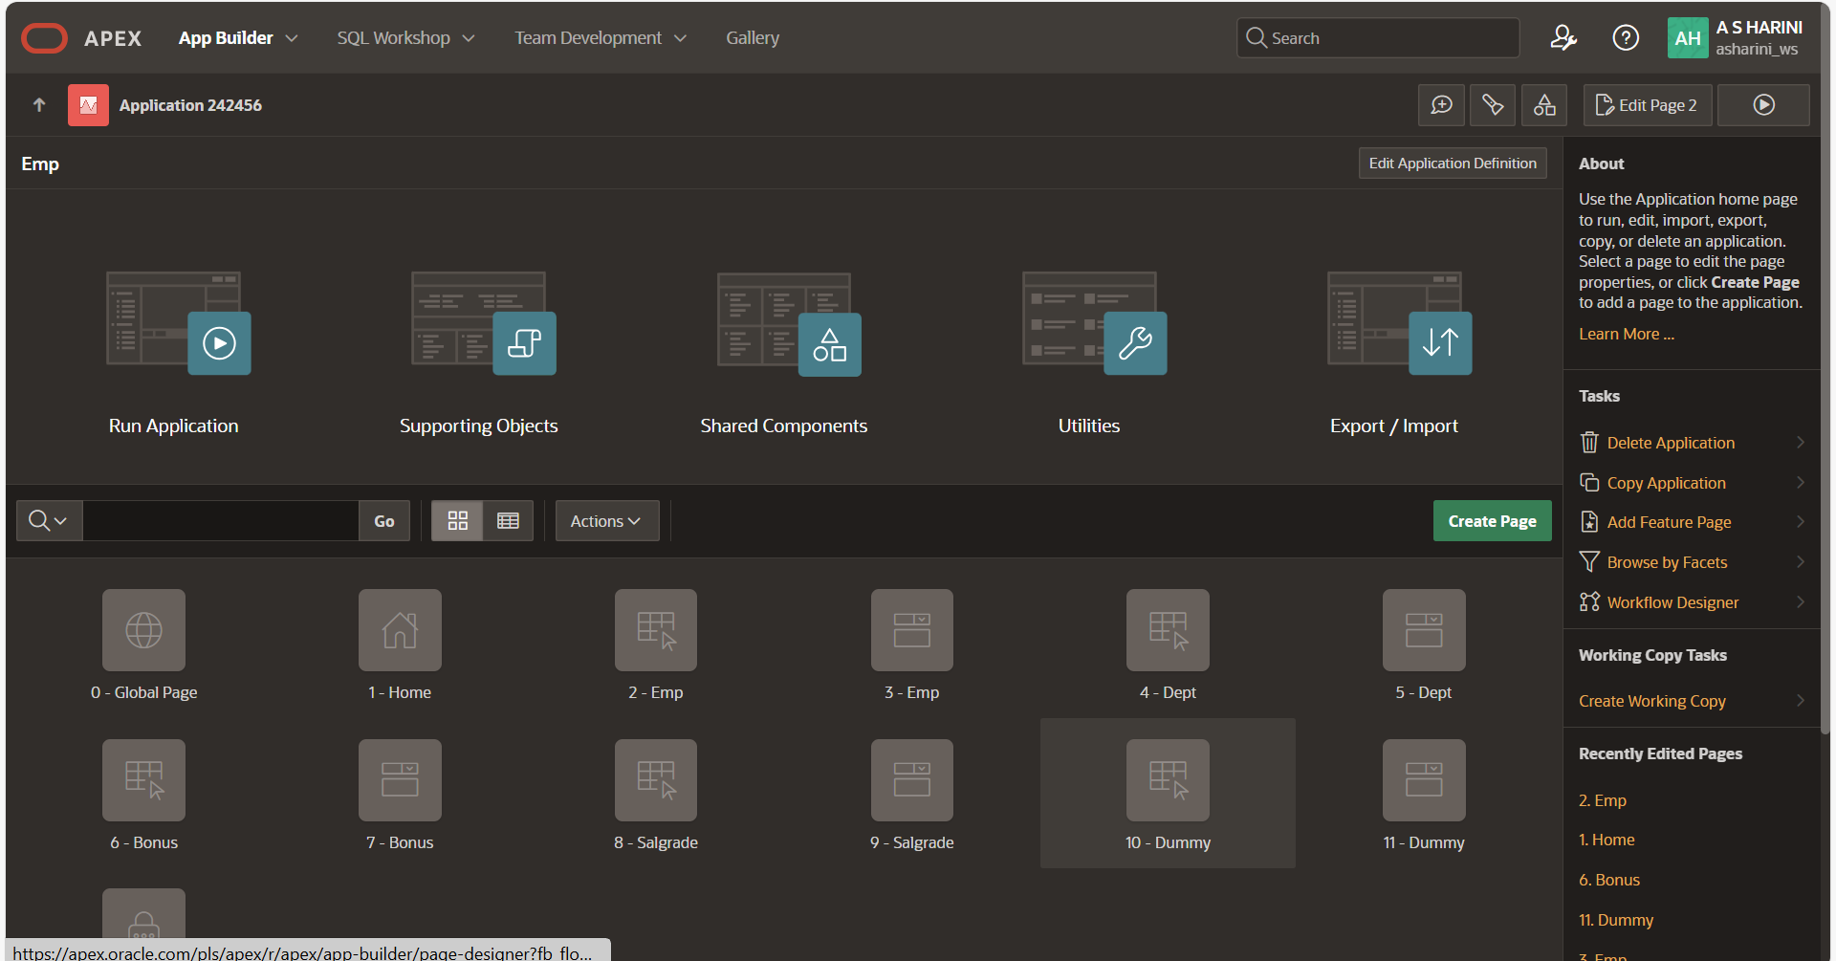
APEX APPLICATION

Slide 16
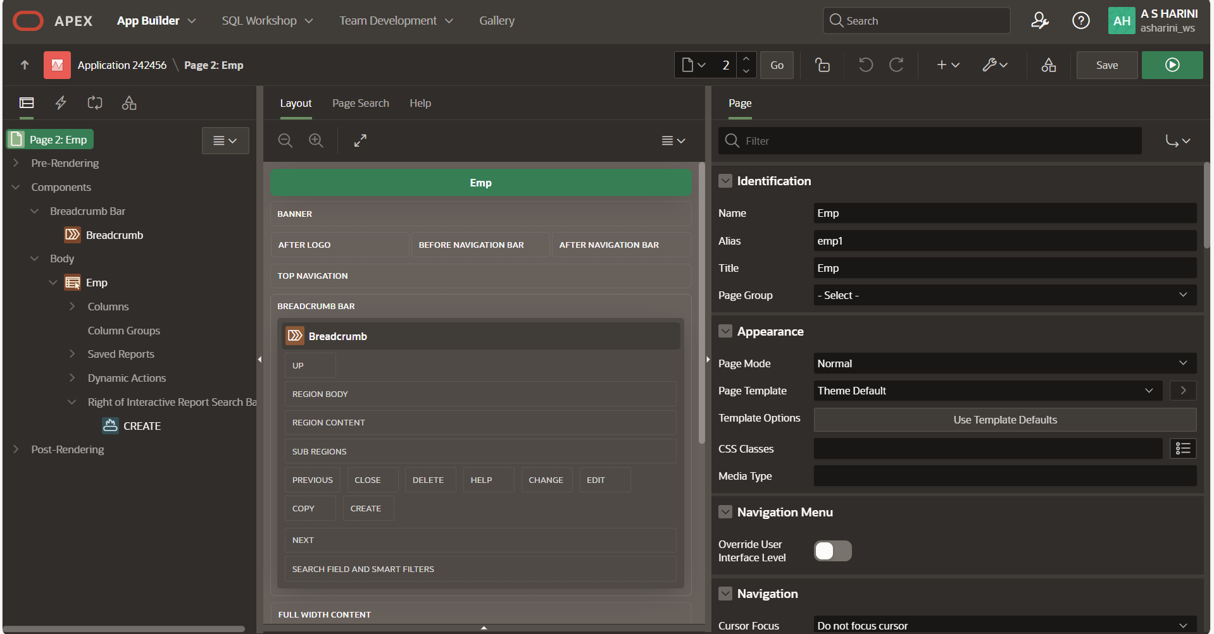
APEX PAGES

Slide 17
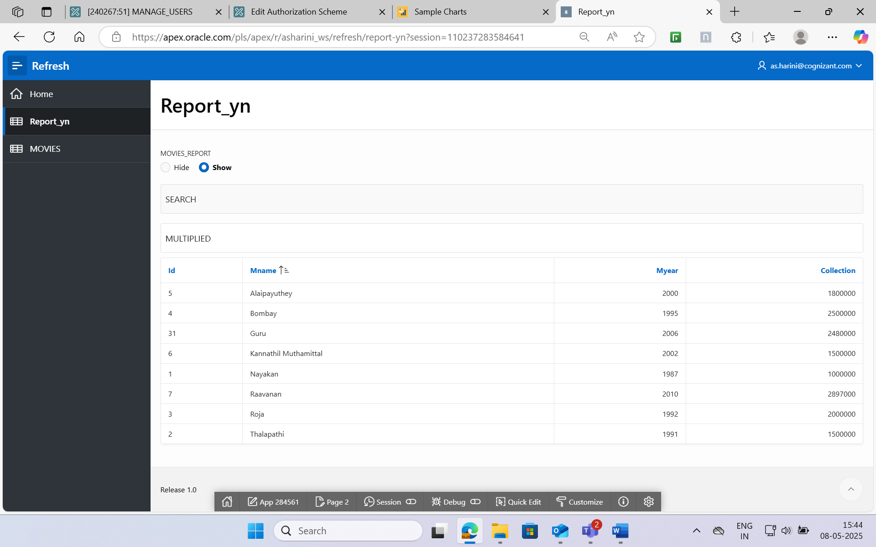
APEX REPORT

Slide 18
VBCS - Visual Builder Cloud Service
Oracle Visual Builder Cloud Service (VBCS) is a cloud-based platform that allows you to develop, collaborate on, and deploy applications within Oracle Cloud.
Key features are:
Visual Development
Customization
Integration

Slide 19
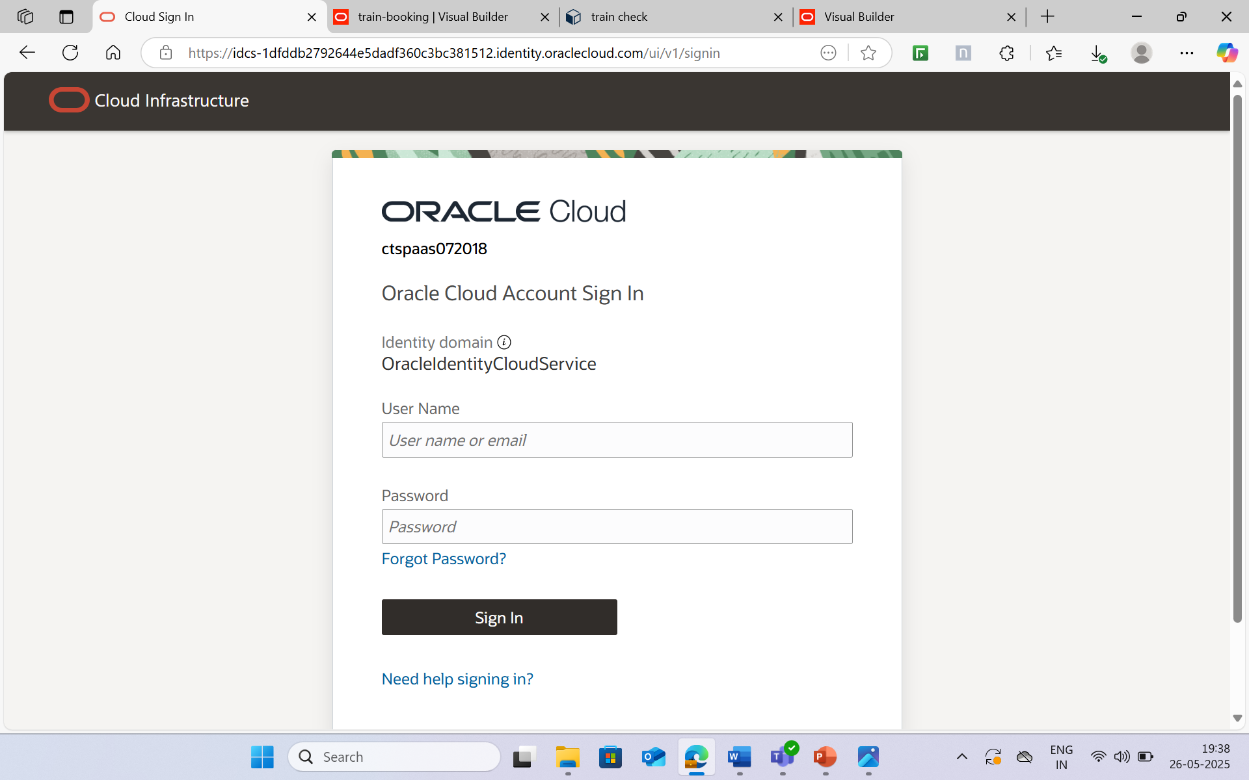
ORACLE HOME PAGE

Slide 20
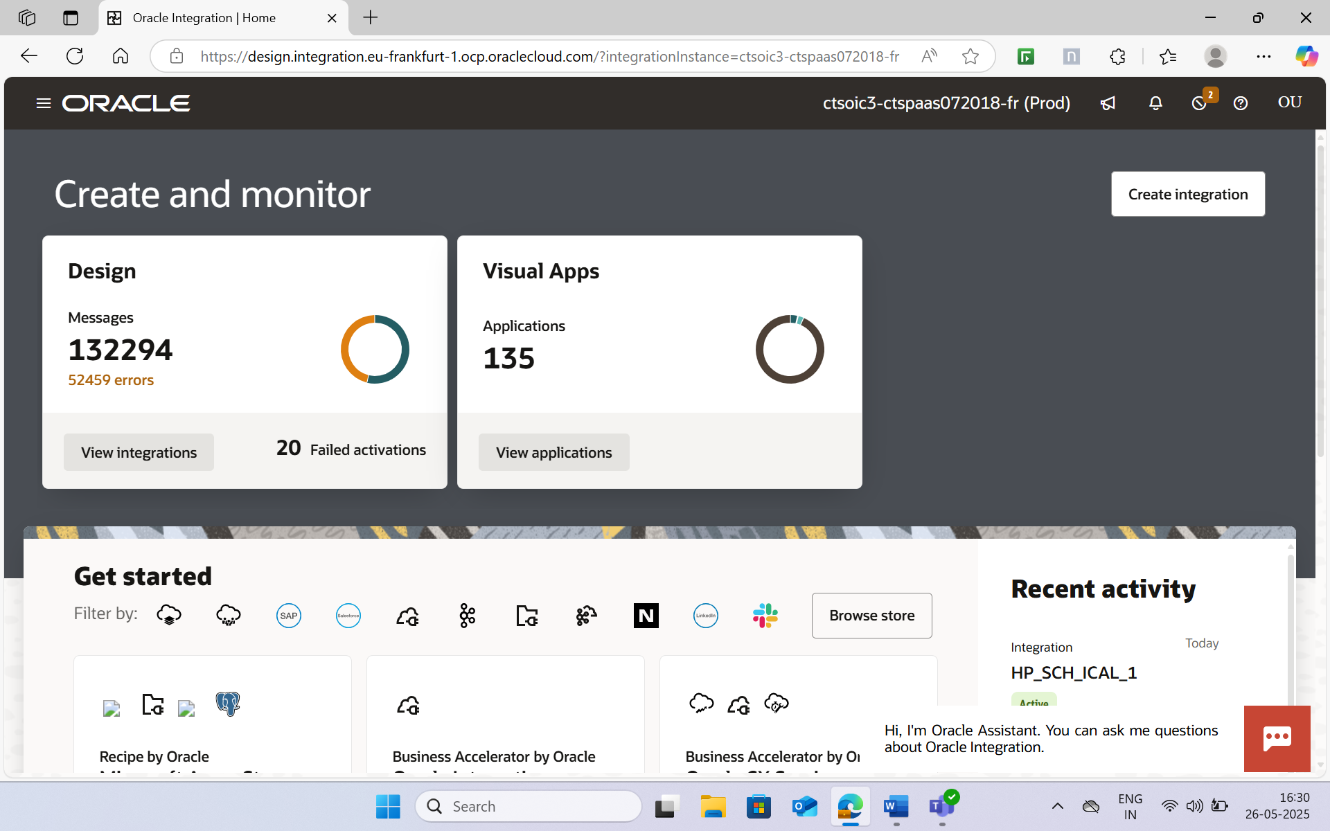
VBCS HOME PAGE

Slide 21
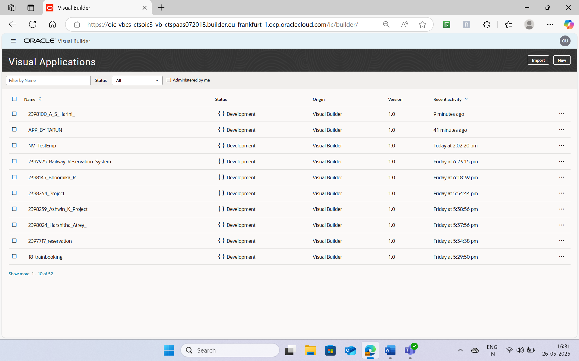
VBCS APPLICATION

Slide 22
SOFT SKILLS
In addition to technical skills, we received soft skills training that covered email etiquette, group discussions, minutes of meeting (MOM) writing, call etiquette, and interview preparation. We also enhanced our teamwork through daily activities and reviews, with a strong focus on professional communication.

Slide 23
GAINED INSIGHTS
We gained practical experience with Oracle APEX, OIC, and OCI, VBCS enhancing our understanding of cloud deployments, workflows, and automation.
Our teamwork and confidence improved through soft skills sessions, which helped build a strong foundation for a career in cloud integration and low-code platforms. Additionally, we learned about various enterprise applications and different Oracle technologies.

Slide 24
CONCLUSION
The internship at Cognizant Technology Solutions offered a valuable opportunity to apply academic knowledge to real-world scenarios. We gained hands-on experience through various projects and activities, developed professional skills, and were exposed to a range of cloud solutions and low-code applications

Slide 25
THANK YOU ☺

